Slide 1
Final SRS Presentation
Lorbek car showroom

Slide 2
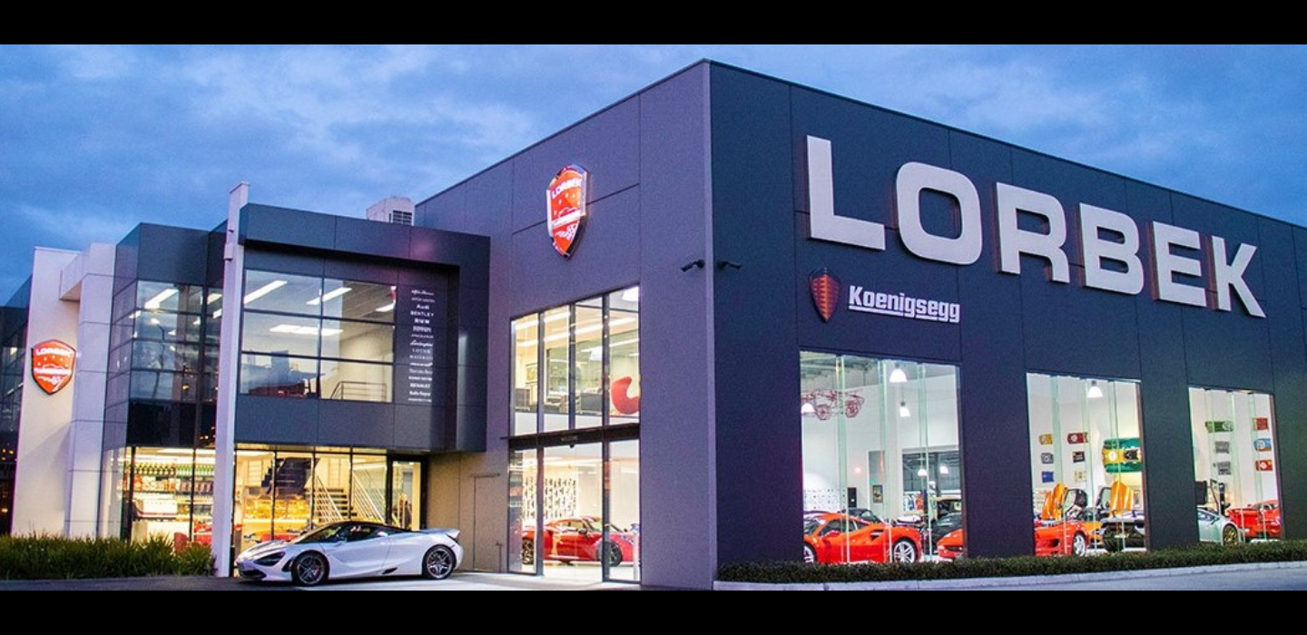
Background
This project aims to use automated software to make things run smoother, reduce mistakes, and improve how the showroom is organized.
The main aim is to use automation to make data more accurate, processes smoothly, and to achieve the overall experience for customers.
This project considers challenges and opportunities in the car industry, aiming to make the showroom strong and able to adapt to changes in the market.

Slide 3
Functional Requirement
Admin
Admin Login
View Dashboard
Create Scheduling Tasks
View Vehicle Inventory
View Available Vehicles
View Stock Levels
Generate Notification Alert
Manage order
View Bookings
View Bookings
Manage users
Manage Accessories
Manage Shipping
Maintain Records
Manage Payment
Create Vendor Invoice
Manage Refund Request

Slide 4
Functional Requirement
User
User registration
User Login
Car search Option
View Car Categories
Choose Filter Options
View Vehicle Information
Watch Videos
Make a Purchase
Create Loan Application
Create a Booking
Create Customer profile
Create a payment
View Shopping Cart
Create Feedbacks and Reviews
View Notifications Alert
Add to Wishlist
Create History and Records
Use Price Calculator
Make Pre-order/Reserve Request
Create Order Inquiry
Create a Refund Request
Use AI API Chatbot

Slide 5
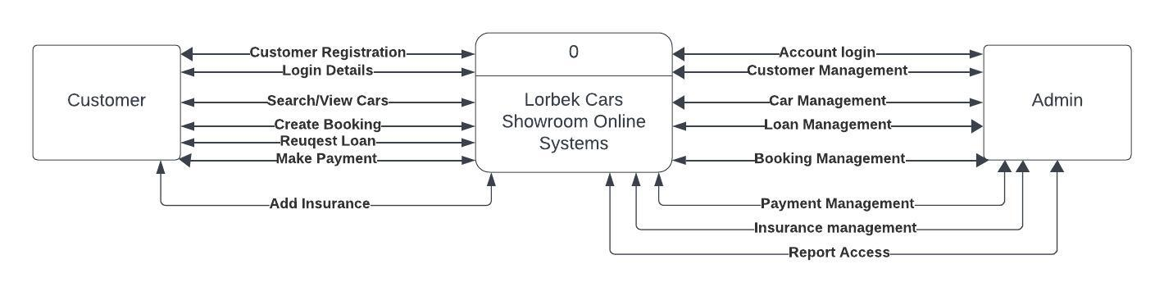
Context Diagram/Diagram Level 0

Slide 6
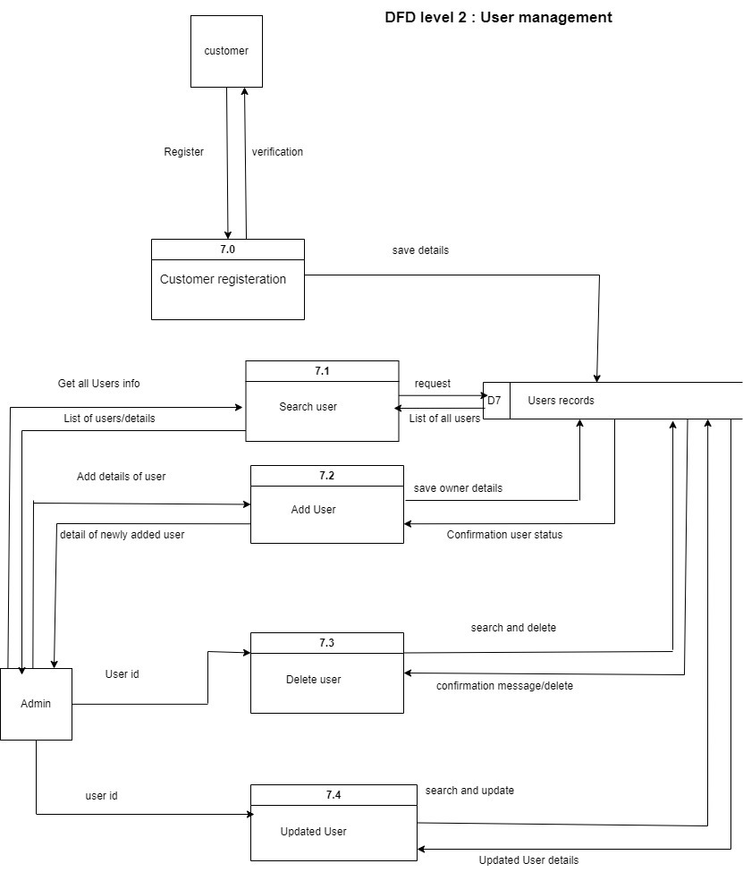
DFD level 2: User Management

Slide 7
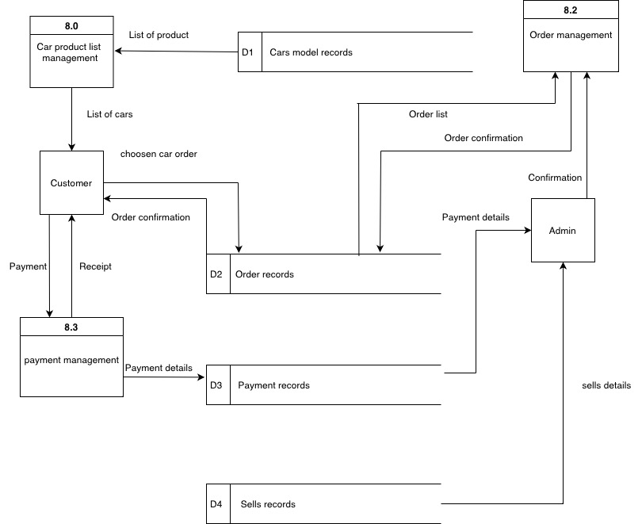
DFD level 2 : Payment management

Slide 8
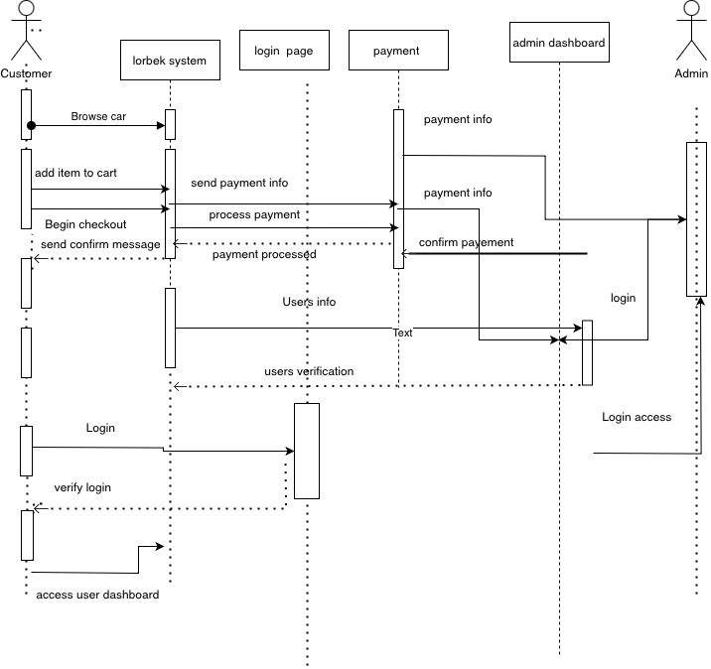
Sequence Diagram

